Slide 1
Oil Spill Cleaner-Upper
Innovation Day main presentation

Slide 2


Slide 3
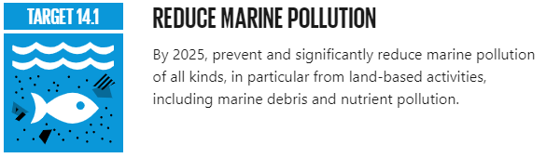

Slide 4
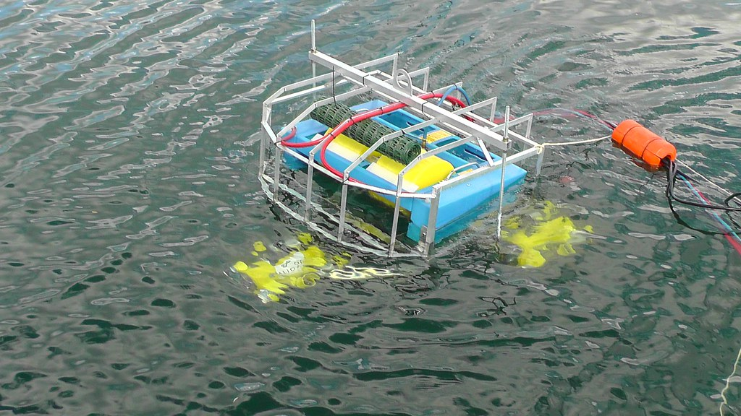
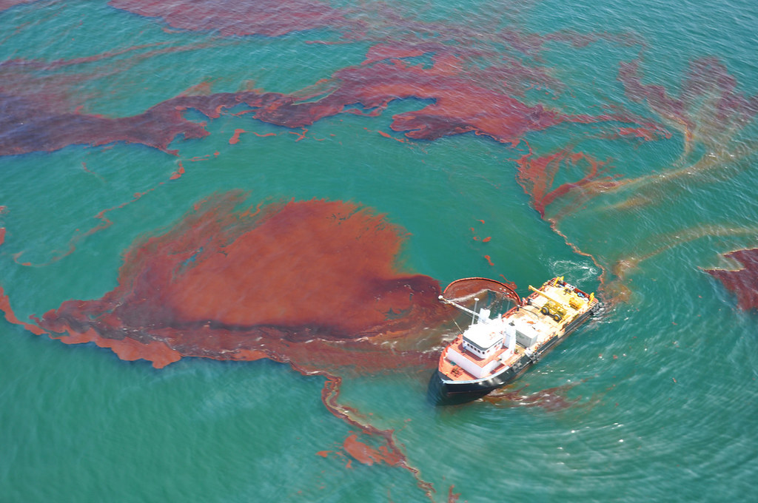
Setting the scene
A group of marine scientists have asked you to develop an algorithm that could be used on a boat drone to drag around a sheet of this smart material to clean up an oil spill.

Slide 5
Success criteria
Build a floating oil spill cleaner-upper boat drone that starts with a button press
The product should be able to autonomously navigate over an area
The product should be made to clean up an oil spill by dragging a ‘smart material’

Slide 6

Input Process Output
Input | Process | Output
Button press | Algorithm to control the movement of the boat drone in a path to clean up oil: | Servo motor control

Slide 7
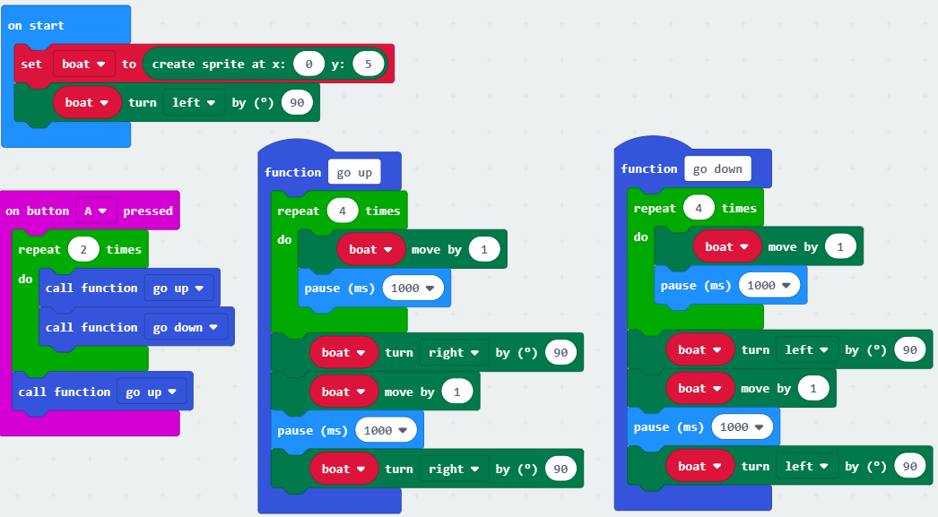
Creating a mock-up
These blocks create an on-screen mock-up using a sprite.
We can use this to test our algorithm on the micro:bit or in MakeCode.

Slide 8
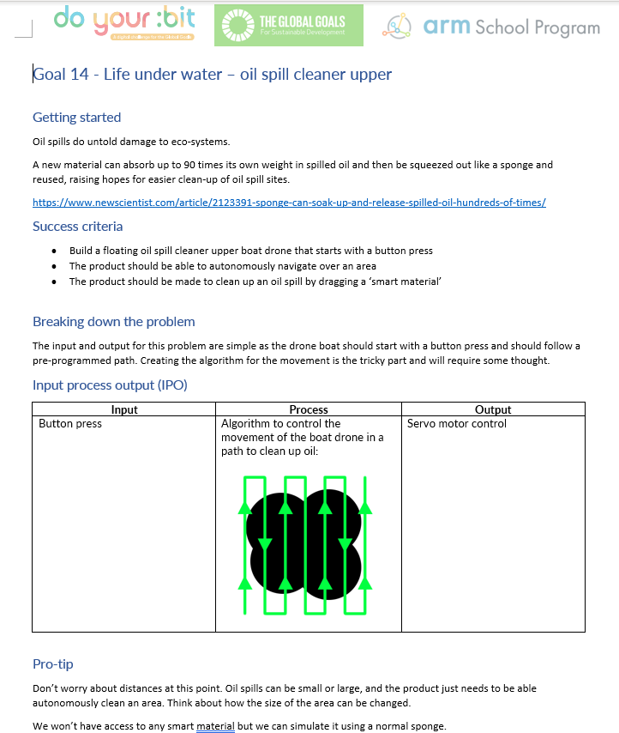
Group task
Get into pairs/groups
Use the Oil Spill Cleaner Upper worksheet to help you design and create your product
The product must meet the success criteria
Use the IPO worksheet to design further features
Make a model tree to test your product

Slide 9
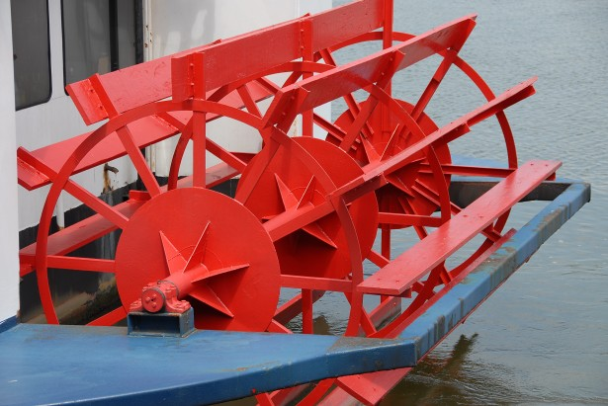
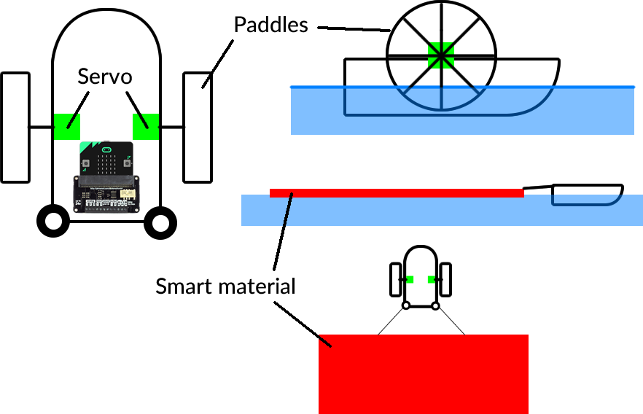
The paddle wheel

Slide 10
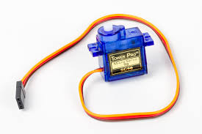
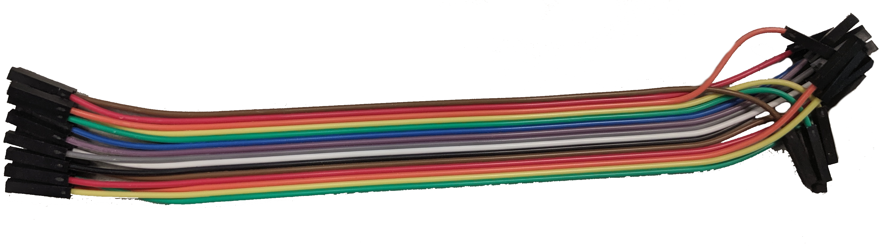
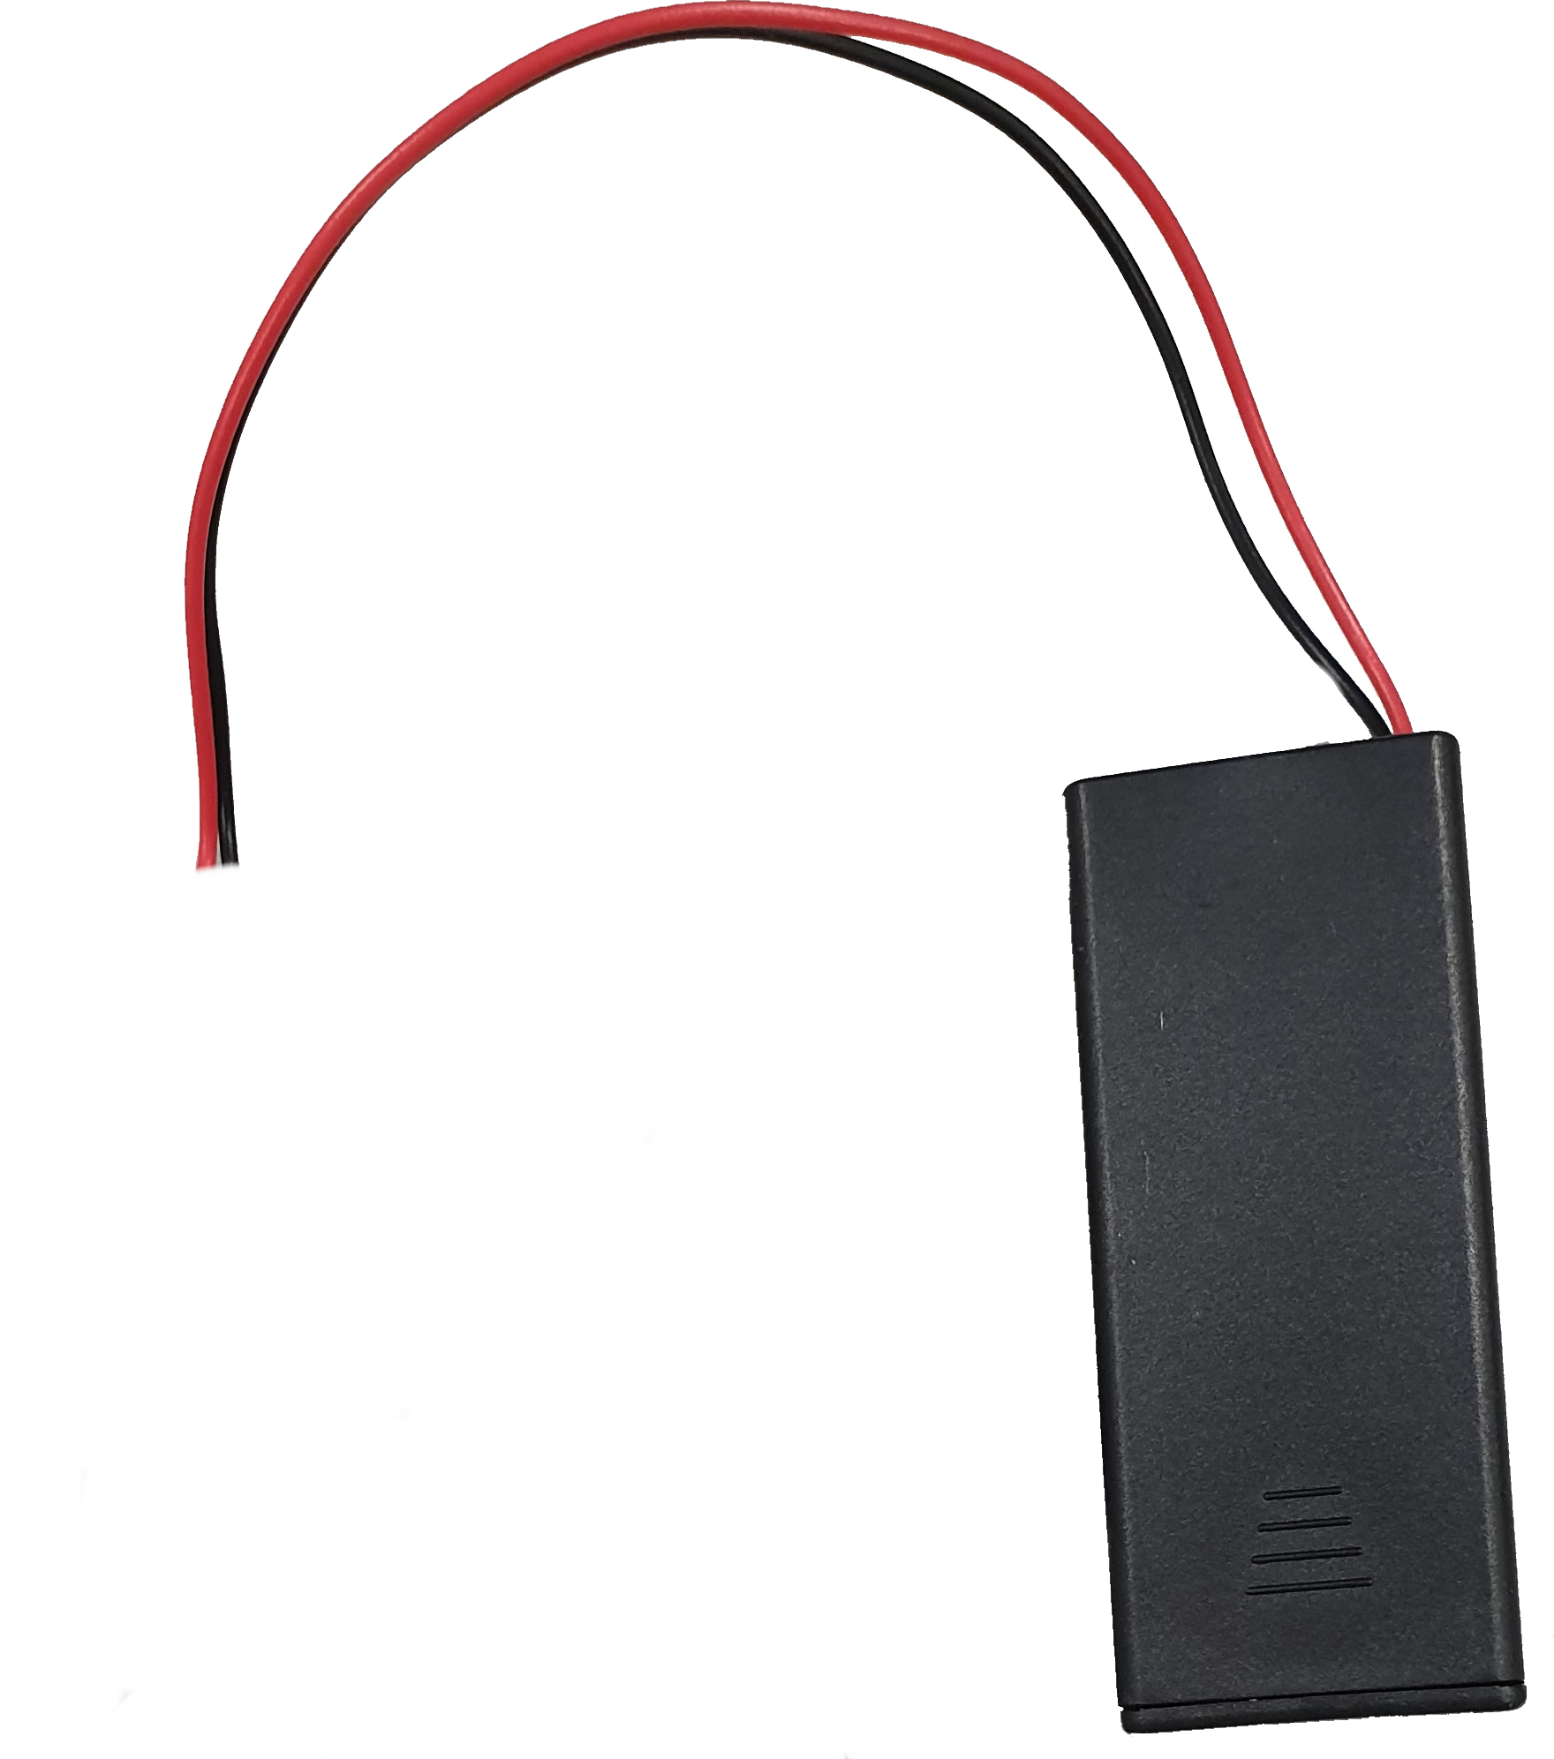
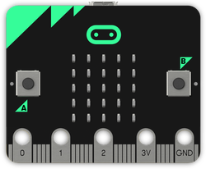
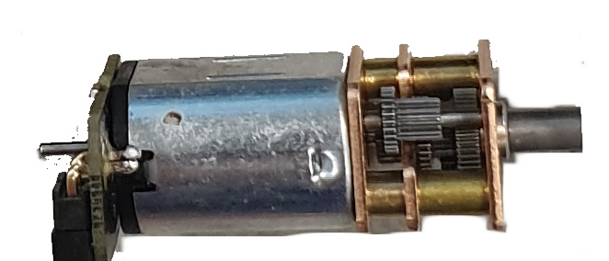
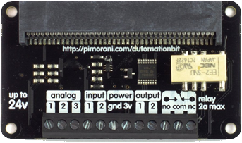
Hardware needed
micro:bit(s)
battery peripheral and batteries
materials to make the floating body and paddles
servo control board
servo motors
a sponge to simulate the smart material

Slide 11
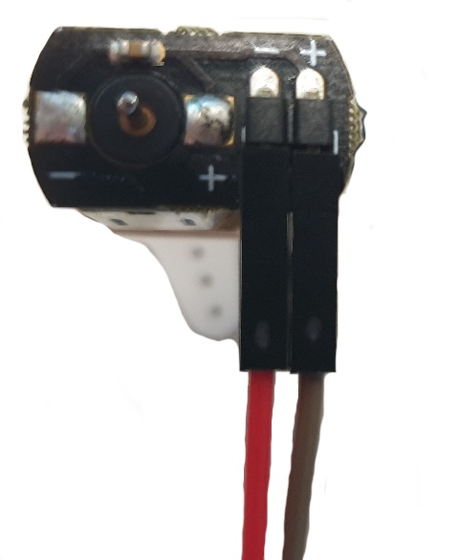
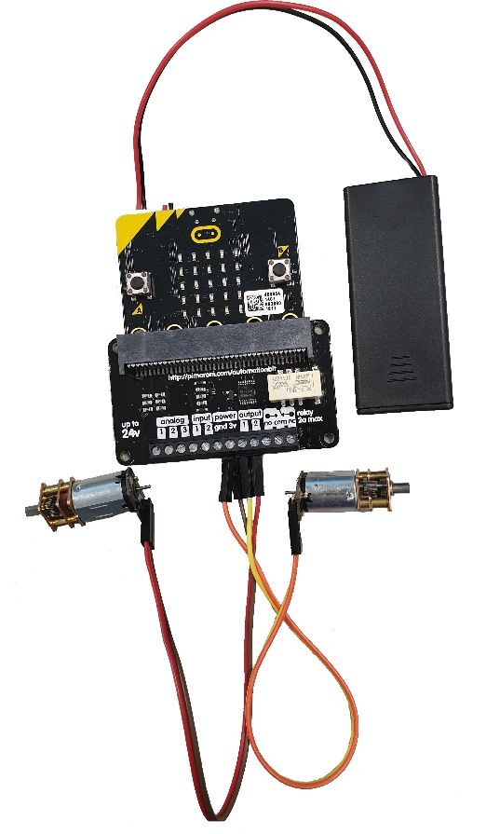
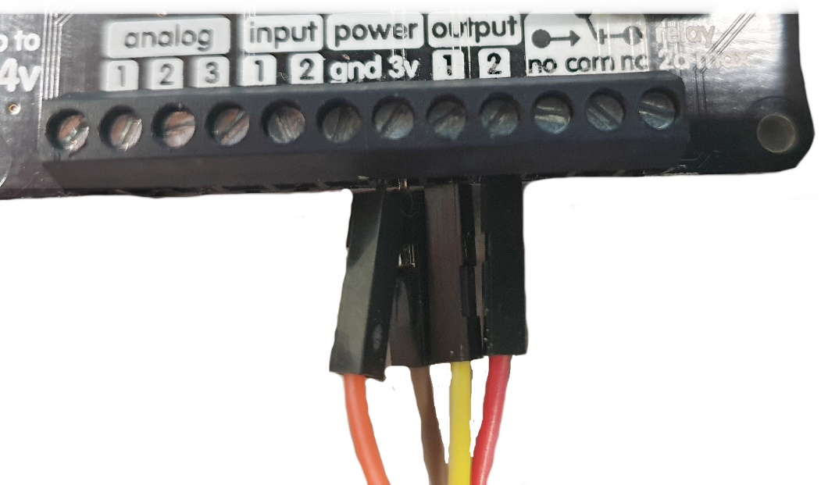
Connecting the motors
The motors need power from the batteries
The + wires from both servos go into the 3v terminal
Output one is right
Output two is left
Ground (GND) wires got to the GND terminal

Slide 12
Success criteria
Build a floating oil spill cleaner-upper boat drone that starts with a button press
The product should be able to autonomously navigate over an area
The product should be made to clean up an oil spill by dragging a ‘smart material’

